Slide 1
Deposition Techniques
1

Slide 2
KEY CONCLUSIONS
2

Slide 3
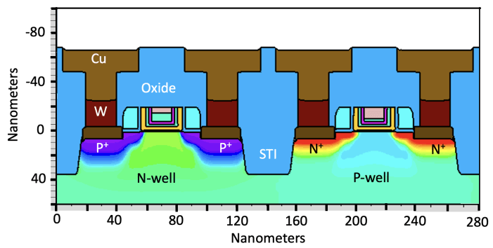
Deposition Systems - Classification
Desirable traits for deposition:
Desired composition, low contaminates, good electrical and mechanical properties.
Uniform thickness across wafer, and wafer-to-wafer.
Good step coverage (“conformal coverage”)
Good filling of spaces.
Planarized films .
Challenge: Filling higher aspect ratio
Process | Abbreviation | Temperature Range | Method
Chemical Vapor Deposition | CVD | 500 - 1100ºC | Gas phase, chemical
Low Pressure Chemical Vapor Deposition | LPCVD | 500 - 800ºC | Gas phase, low pressure chemistry
Metal-Organic Chemical Vapor Deposition | MOCVD | 600 - 1200ºC | Gas phase chemistry
Plasma Enhanced Chemical Vapor Deposition | PECVD | 300 - 450ºC | Plasma chemistry
Atomic Layer Deposition | ALD | 100 - 400ºC | Chemistry
Plasma Sputtering | Sputtering | 100 - 300ºC | Physical deposition
Evaporation | Evaporation | 100 - 500ºC | Physical deposition
Molecular Beam Evaporation | MBE | 100 - 400ºC | Physical deposition
Step Coverage
Aspect Ratio: H/W
Formation of Voids
3

Slide 4
Chemical Vapor Deposition
• Atmospheric Pressure
• Gas Phase Reactions
• Typically high T (500 –1100 ˚C)
• Most common application is epitaxial growth.
• High T provides surface mobility so single crystal
films can grow.
SiO₂
4

Slide 5
CVD Growth rate
h_{G}- mass transfer coefficient (in cm/sec).
k_{S} - the surface reaction rate (in cm/sec).
F = F₁ = F₂
In steady state:
Kinetic Limited Regime
Mass Transport Limited Regime
SiO₂
N - number of atoms per unit volume in the film (5 x 10²² cm⁻³ for the case of epitaxial Si deposition)
Y - the mole fraction (partial pressure/total pressure) of the incorporating species.
Growth Rate
5

Slide 6
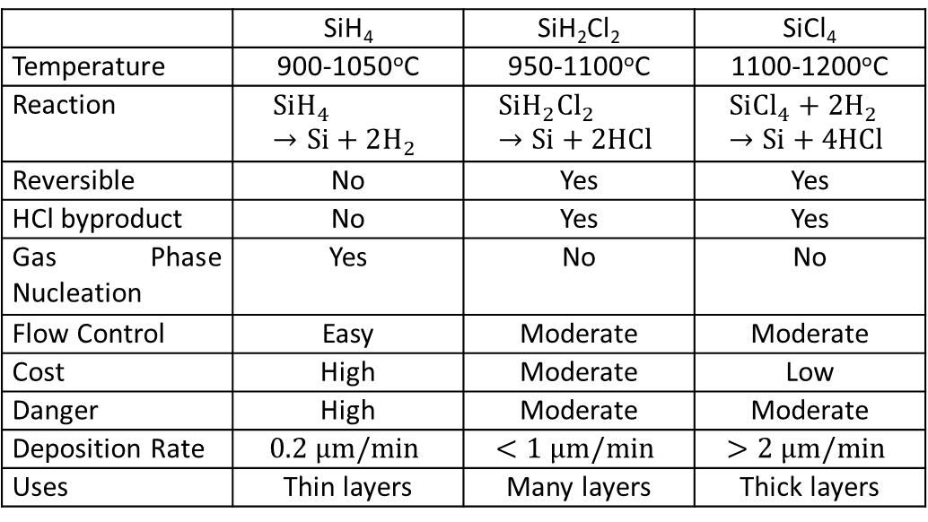

The two limited Regimes
• Mass transport is more or less independent of T
• Rate Kinetics is exponentially dependent on T
• In both regimes the growth rate is constant with time
$$k_{S}= k_{O} exp\left(− \frac{E_{A}}{kT}\right)$$
 | SiH₄ | SiH₂Cl₂ | SiCl₄
Temperature | 900-1050ºC | 950-1100ºC | 1100-1200ºC
Reaction | $$SiH_{4} →Si+2H_{2}$$ | $$SiH_{2}{Cl}_{2} →Si+2HCl$$ | $$Si{Cl}_{4}+2H_{2} →Si+4HCl$$
Reversible | No | Yes | Yes
HCl byproduct | No | Yes | Yes
Gas Phase Nucleation | Yes | No | No
Flow Control | Easy | Moderate | Moderate
Cost | High | Moderate | Low
Danger | High | Moderate | Moderate
Deposition Rate | $$0.2 μm/min$$ | $$<1 μm/min$$ | $$>2 μm/min$$
Uses | Thin layers | Many layers | Thick layers
APCVD Set up
Autodoping
• Epitaxy is usually done at high T in the h_{G} dominated regime.
• Gas flow dynamics are very important.
• During growth dopants can be incorporated both by upward diffusion and autodoping
6

Slide 7
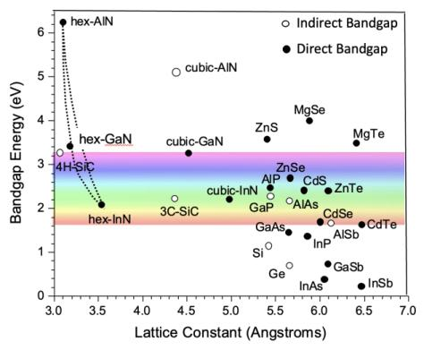
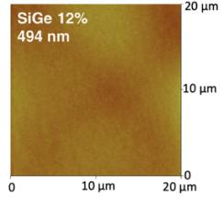
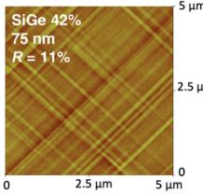
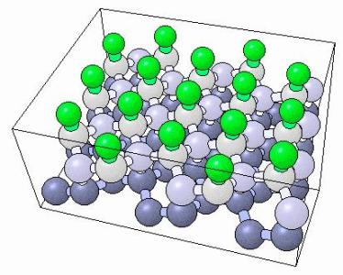
Heteroepitaxy
• Growing of dissimilar material on a substrate
• Lattice mismatch introduces Strain
• Large strain introduces defects
Optimal Strain is used in enhancing mobility
Used for growing III-V semiconductors
Wide Band gap tuning applications
Buffer layer growth for minimize lattice mismatch
Si(111) is preferable due to hexagonal structure
7

Slide 8
LPCVD
• Atmospheric pressure CVD is horizontal configuration
• Only a few wafers at a time
• At low T deposition rate is slow
Decreasing pressure increases mass transfer coefficient
Mass transport is no longer time limited
Process depends on temperature
Temperature can be controlled precisely using modern control systems
8

Slide 9

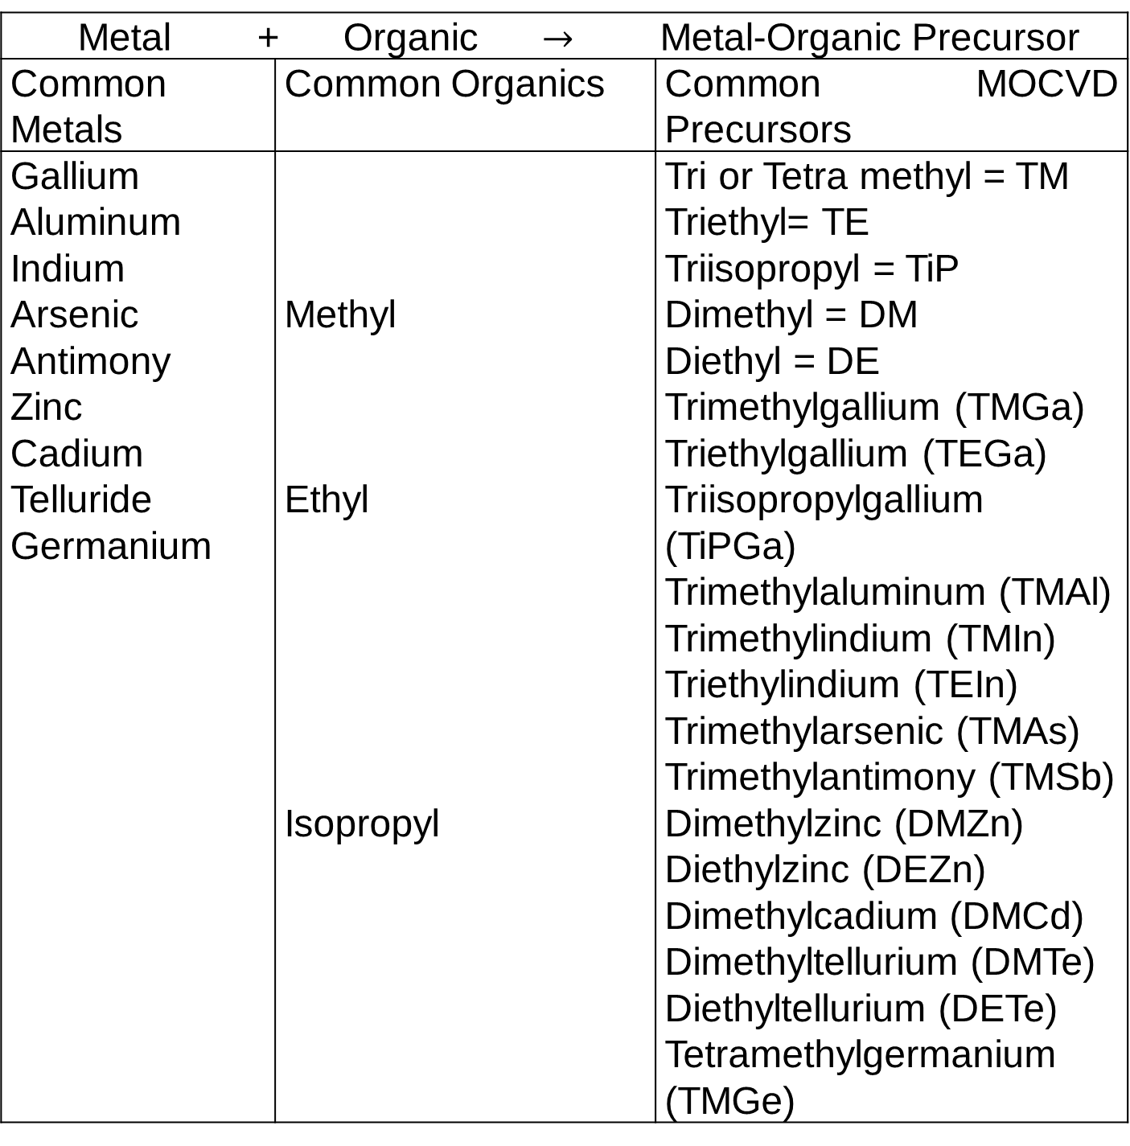

CVD of Compound Materials - MOCVD
Metal + Organic $→$ Metal-Organic Precursor
Common Metals | Common Organics | Common MOCVD Precursors
Gallium Aluminum Indium Arsenic Antimony Zinc Cadium Telluride Germanium | Methyl Ethyl Isopropyl | Tri or Tetra methyl = TM Triethyl= TE Triisopropyl = TiP Dimethyl = DM Diethyl = DE Trimethylgallium (TMGa) Triethylgallium (TEGa) Triisopropylgallium (TiPGa) Trimethylaluminum (TMAl) Trimethylindium (TMIn) Triethylindium (TEIn) Trimethylarsenic (TMAs) Trimethylantimony (TMSb) Dimethylzinc (DMZn) Diethylzinc (DEZn) Dimethylcadium (DMCd) Dimethyltellurium (DMTe) Diethyltellurium (DETe) Tetramethylgermanium (TMGe)
For Si CMOS applications, we mostly deposit epitaxial Si films, or we deposit dielectrics like SiO₂, Si₃N₄.
Many compound semiconductor applications require epitaxial growth of III-V materials. MOCVD is used..
More “unstable” precursors like TEOS allow deposition of silicon materials at lower T.
(11)
Many such prescursors have been developed for compound semiconductor materials.
These are metal-organic precursors, hence MOCVD.
Example:
(12)
$$Si{\left(OC_{2}H_{5}\right)}_{4 } →SiO_{2} +2{\left(C_{2}H_{5}\right)}_{2}O$$
$$Ga{\left(CH_{3}\right)}_{3}+AsH_{3} →GaAs+3CH_{4}$$
9

Slide 10
Typically these systems operate in the “h_{G}” dominated regime so boundary layer transport is critical.
Uniform growth means optimizing the gas flow pattern.
Typically vertical flow reactors and rotating
substrates are used to achieve a uniform δ.
Normally operate at 500 – 800 ˚C and moderate pressures (0.1 – 1 atm).
10

Slide 11
Plasma Enhanced CVD (PECVD)
and HDPCVD Systems
Non-thermal energy to enhance processes at lower temperatures.
Plasma consists of electrons, ionized and neutral molecules, neutral and ionized fragments of broken-up molecules, excited molecules, free radicals.
Free radicals are electrically neutral species with incomplete bonding, extremely reactive. (e.g. SiO, SiH₃, F).
High density plasma (HDPCVD) systems add a “third knob” to produce higher densities of reactive species. SiO₂ deposition shown where O₂ is less reactive.
Deposition is mass transport limited so relatively T independent. Ion bombardment can help to densify films.
11

Slide 12
Atomic Layer Deposition (ALD)
Similar in chemistry to CVD, except that in ALD the reaction is broken down into two half-reactions, keeping the precursor materials separate during the reactions. Al₂O₃ example below.
ALD film growth is self-limited and based on surface reactions, which makes achieving atomic scale deposition control possible.
12

Slide 13
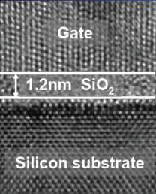
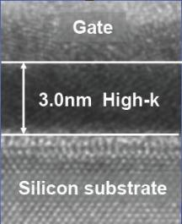
Atomic Layer Deposition (ALD)
One TMA and one H₂O vapor pulse form one cycle. Here two cycles are shown, with approximately 1 Angstrom per cycle. Each cycle includes pulsing and pumping takes about 3 seconds.
Two half reaction steps in each cycle
The net result is that atomically controlled layers can be deposited.
(13)
(14)
ALD Applications
High-K dielectrics for CMOS
Candidates for High-K dielectrics
Film Precursors
Al₂O₃ Al(CH)₃, H₂O or O₃
HfO₂ HfCl₄ or TEMAH, H₂O
ZrO₂ ZrCl₄, H₂O
12

Slide 14
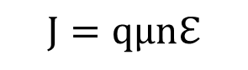
Physical Deposition Systems - DC Sputter Deposition
DC plasma systems were not discussed in Chapter 9. They have almost no use in etching.
For sputtering conductive materials this is a simple and effective approach.
Dc voltage high enough to ionize gas is applied (500 – 1000 volts) depending on geometry.
Cathode and anode voltage are fixed externally. The plasma takes on a small positive potential.
DC current must be continuous. Cathode current is largely ions, anode current is largely electrons.
Because µ is so different for ions and electrons, +V_{P} is set up to balance the two currents.
$$J=qµnℇ$$
13

Slide 15
If Ar gas is used in the plasma, Ar⁺ ions hit the target at high energy, sputtering material which can then diffuse and deposit on the substrate (wafer).
This works well for conductive materials (metals, silicides . .) including alloys and compounds.
The system on the right is a practical implementation, minimizing DC current through the substrate.
Magnetron sputtering adds magnets on the cathode to trap e⁻ so they are not free to bombard the target. This improves the efficiency of deposition.
DC sputtering works typically between 5 – 50 mT. Thus many collisions occur between ions and neutrals resulting in a wide angular distribution of the incoming depositing material atom.
Reactive gases (e.g. N₂) can be added to the plasma. Ti sputtering TiN (see text).
13

Slide 16

RF Sputter Deposition
For DC sputtering, target electrode must be conducting. To sputter dielectric materials use RF power source.
As we saw in Chapter 9 (Fig. 9.9), if the electrode areas are not equal, the field is higher at the smaller electrode (higher current density), to maintain AC current continuity.
V_{DC} is set up automatically by the plasma. It must be large enough (10 – 20 eV) to cause sputtering.
The voltages across the two sheaths are
Wafer electrode can be connected to chamber walls further increasing the voltage ration.
$$\frac{V_{1}}{V_{2}}≈ {\left(\frac{A_{2}}{A_{1}}\right)}^{m}$$
(m = 4 in theory and 1-2 experimentally) (19)
13

Slide 17
Physical Deposition Systems - Evaporation
In evaporation, source material is heated or E-beam is used in a vacuum chamber.
Mostly line-of-sight deposition since pressure is low.
Deposition rate is determined by emitted flux and by geometry of the target and wafer holder.
Ideal point sources emit isotropically.
Realistic planar sources emit with a cosq distribution.
Placing a small planar source at the base of a sphere results in more uniform deposition.
The angular drop-off in emitted flux is compensated by the shorter distance.
13

Slide 18
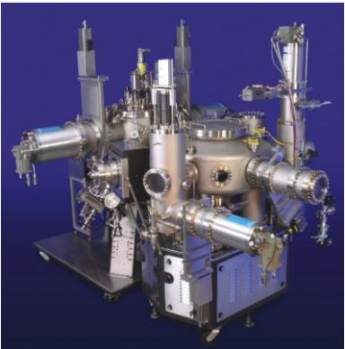
Molecular Beam Epitaxy - MBE
Operates under high vacuum, line of sight deposition, epitaxial layers can be deposited if substrate is heated to
provide thermal energy.
Deposition rate usually slow so epitaxial growth can occur (≈ 1 atomic layer/sec).
“Effusion” sources used to evaporate elements needed for thin films to be deposited. T of effusion cells controls relative evaporation rates.
Widely used in university and industry research, generally too slow for manufacturing.
13

